Slide 1
FEM2401 Malaysian Politics & Society TOPIC 9: LEGISLATIVE AND JUDICIARY
Lecturer:
MUHAMMAD AMIR BIN MUNSHI

Slide 2
CONTENT:
Background of Malaysian legal system
The function of legislative
Malaysian Parliament
House or Representatives
House of Senate
Drafting the Law
Judiciary institution
The functions of the judiciary
Law and the judiciary
Court structure and system
Judges
Judicial independence
LEARNING OUTCOME:
To understand the basic legal and judicial system in Malaysia
To explain the function legislative and judiciary in Malaysia

Slide 3
LEGISLATIVE AND JUDICIARY
THE PURPOSE OF LAW
Establishing Standards
Maintaining Order
Resolving Disputes
Protecting Liberties and Rights
Important government machinery to protect the society/citizen through legal system
Mechanism of check and balance in the system

Slide 4
BACKGROUND OF LEGAL AND JUDICIAL SYSTEM IN MALAYSIA
Malaysian legal system is an integration of the common law, Syariah law and customary law traditions
Customary law – Malay adat (later modified by Islamic law)
Islamic law tradition – started from Malacca empire
Common law – British –Strait Settlements through Royal Charters of Justice 1807
Other customary law– Aboriginal customary law, Chinese, Indian, Hindu and Native customary law of non-Malay indigenous communities of Sabah and Sarawak

Slide 5
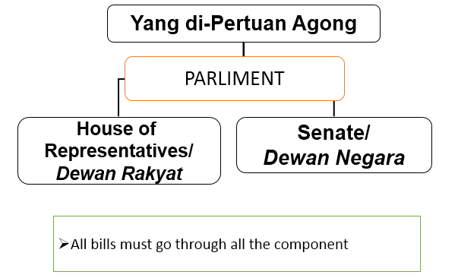
THE FUNCTIONS OF PARLIAMENT (LEGISLATIVE)
To legislate, amend, abolish and approve laws
To introduce new taxes or abolish taxes
To approve annual budget (every October)
PARLIAMENT COMPONENT

Slide 6
YANG DI-PERTUAN AGONG
Head of the legislation body
His not directly involved in the process of making the laws, only approved the bill
Power to call a meeting, stop and dissolve Parliament
The Yang Di Pertuan Agong must call for a parliament meeting within 120 days after it has been dissolved

Slide 7
DEWAN NEGARA (SENATE)
The Upper House of the Parliament of Malaysia.
Consists of 70 members, of which 26 are indirectly elected by the states, with two senators for every state in the Federation, and the other 44 being appointed by the Yang di-Pertuan Agong.
The role - reviews legislation that has been passed by the lower house of Parliament, the House of Representative.
Originally, the Senate was meant to act as a check on the Dewan Rakyat, and also to represent the interests of the various states.
DEWAN NEGARA : MEMBERSHIP
Appointment by DUN/State Assembly
2 from each state (26)
Appointment by YDPA
4 from Federal Territories (2 KL, 1 Labuan, 1 Putrajaya)
40 appointed by YDPA from various fields/expertise
The term of office
3 years – may only be reappointed once only
Qualification
Malaysian
Must be at least 30 years old
Residing in the Federation
Must not have received a prison sentence of one year or longer
Must not have been fined RM2,000 or more

Slide 8
DEWAN RAKYAT (HOUSE OF REPRESENTATIVES)
The lower house of the Parliament of Malaysia.
Lower house but important chamber
The role - to discuss on the fiscal or budget and to make /amend the law while the Senate adjourned the meeting
Have the right to decide matter pertaining the fiscal policy
All bills must usually be passed by both the House of Representatives and the Senate, before it has been approved by the Yang di-Pertuan Agong.
Members of the Dewan Rakyat are often referred to as Members of Parliament or MPs – currently 222 MP
DEWAN RAKYAT: MEMBERSHIP
222 members
Johore (26), Kedah (15), Kelantan (14), Melaka (6), Negeri Sembilan (8), Pahang (14), Pulau Pinang (13), Perak (24), Perlis (3), Sabah (25), Sarawak (31), Selangor (22), Terengganu (8)
13 from Federal Territories
11 WPKL, 1 WPL, 1 WPP
The term of office
5 years or until Parliament dissolved
Qualification
Same with eligibility for election candidate

Slide 9
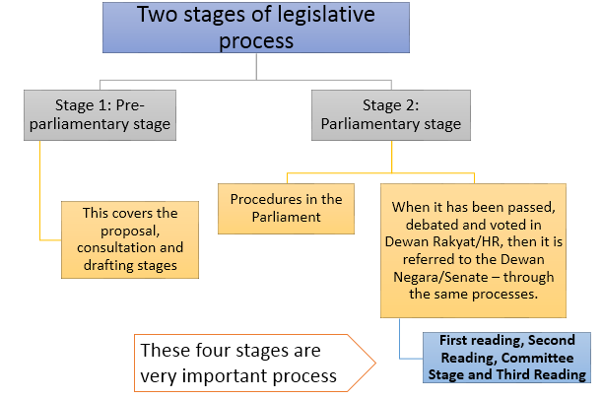
LEGISLATIVE PROCESS
A bill may originate in either Dewan/Houses. But most often originates in the Dewan Rakyat and normally introduced by a minister
Bills concerning tax or expenditure (money or Supply Bills) must originate in the Dewan Rakyat.
Senate cannot reject a bill but can postponed the bill to be submitted to the King.

Slide 10
DRAFTING A BILL
Stage 1: Pre-Parliamentary Stage
Drafting the proposal (At Ministry level/Minister)
series of discussion with various related organisation – may even be public discussion in the media
Expert and interested outside bodies may be consulted
Consultation with Attorney General
To be put into legal language and form
Cabinet approval
After the approval the bill is ready to be introduced into Parliament

Slide 11

Stage 2: Parliamentary Stage
FIRST READING
Minister formally introduces the Bill in the Dewan Rakyat /HR (House of Representative) by having its short title read. No debate or amendment
The Bill is printed & circulated.
SECOND READING
Debate on the general principles of the Bill, The general principles and the implication of the bill are debated;
MPs will vote , either a simple majority of the present member of the parliamentary, or two-third majority of the total number of parliamentary in accordance with the requirement of the Federal Constitution. If rejected, it could be modified & presented again or stops at this stage.
COMMITTEE STAGE
Detailed examination/discussion of the Bill and consideration of amendments (Amendment will be carried out if necessary), followed by a report on the Bill to the HR.
THIRD READING
Reviewing the bill. Further debate on the general principles of the Bill, followed by a vote

Slide 12
DEWAN NEGARA
The bill is submitted to Dewan Negara
Repeat the First, Second, Committee Stage and Third Reading. If passed, the bill is referred back to the Dewan Rakyat
ROYAL ASSENT
The Yang di-Pertuan Agong affixes the Public Seal (GAZZETTE) within thirty days of presentation
Bill becomes Act
PUBLICATION
Act comes into force

Slide 13
DEFINITION OF LEGISLATION TERMS
Acts – Laws enacted by the Parliament
Ordinances –
Laws enacted by the Parliament between 1946-1959
Laws promulgated by the Yang di-Pertuan Agong during an emergency proclaimed under Article 150 of Federal Constitution
Enactments – laws enacted by State Legislative Assembly (except in Sarawak- are called Ordinances)
TYPE OF BILLS
Public bills: Involved the affairs of public/community
Private bills: Local and personal matters
Hybrid bills: Public bills but deal with private matters

Slide 14
POSITION IN THE PARLIAMENT
Yang Dipertua/Speaker (of Both Houses)
Chairing the Parliament session/meeting
Timbalan Yang Dipertua/Deputy Speaker (of both houses)
2 persons will take the place in the absence of the Speaker
Secretary
Head of Administration, managing the session in the Parliament
Leader of Opposition
Appointed by the Opposition Party – among the MPs who won the election
Chief Whip
A Member of Parliament (MP) who is appointed to ensure each MP votes in accordance with their respective party line when necessary.
Head of session/meeting
Head of the governing body – Prime Minister. He decides the date of the Parliament session

Slide 15
SPEAKER/PRESIDENT OF DEWAN NEGARA (SENATE)
The President of The Senate must be a Member of the Senate. He must be a member of the Senate and is assisted by Deputy President which is also the Member of the Senate.
Roles of the President include :
to keep order and ensure that debates run smoothly;
to ensure the relevancy of the points raised during the debate; and
to interpret the Standing Orders in case of disputes and the decision is final.
The President and the Deputy hold office until he/she ceases to be a Senator.
Any person who wants to assume the post of the President of the Senate must not be a member of any State Legislative Assembly.
SPEAKER OF DEWAN RAKYAT
(HOUSE OF REPRESENTATIVE)
Speaker may be a member of the House or a non-member who is qualified for election into the House.
The speaker cannot vote if he is appointed among non-member
The Deputy must among the member of the House
Functions of the Speaker:
to be responsible for maintaining order in the House
to ensure that relevancy is observed during debates
to interpret the Standing Orders in case of disputes
The Speaker may vacant his office in the following cases:
when the House first meets after a general election
on ceasing to be a member of the House in the case of an elected MP
if at any time the House resolves that the Speaker vacant his office

Slide 16
THE PARLIAMENT’S SESSION/MEETING
The official opening of Parliament session by Yang di-Pertuan Agong
Must call for a parliament meeting within 120 days after it has been dissolved
Budget session
Annually at the final week of October
Strategy and financial plan
PARLIAMENTARY PRIVILIGES
Under the Article 63 Federal Constitution and and Sections 3 and 7 of the Houses of Parliament (Privileges and Powers) Act 1952
Parliamentary privilege refers to the rights and immunities of members of Parliament (both Dewan Negara and Dewan Rakyat) to fulfils their duty as the people representatives.
Freedom of speech and debate​​​​
Immunity of members from civil or criminal proceedings for anything done or said before the House

Slide 17
However, Article 63(4) also says that the privilege would not protect MPs if they’ve made seditious remarks or speech. Through amendments made after the May 13, 1969 riots, the privilege does not apply to any person charged with the Sedition Act 1948 and laws enacted under Article 10 (4) which protect the national language, the special position of the Malays and natives of Sabah and Sarawak and commenting on the position of the Yang di-Pertuan Agong and the Malay rulers.
Federal Constitution under Article 63 states:
(1) The validity of any proceedings in either House of Parliament or any committee thereof shall not be questioned in any court.
(2) No person shall be liable to any proceedings in any court in respect of anything said or any vote given by him when taking part in any proceedings of either House of Parliament or any committee thereof.
(3) No person shall be liable to any proceedings in any court in respect of anything published by or under the authority of either House of Parliament.

Slide 18
THE FUNCTION OF JUDICIARY
• Interpret and application of law
• Judicial functions
• To assist in delivering justice
• To determine the facts of law
• “Prosecution and defense
• Guardianship of the constitution
• Protector against the possible excesses of legislative and executive organs
• Special Role in a Federation
• Law-making role – court verdict/decision

Slide 19
JUDICIARY IN MALAYSIA
The MAIN function of the Judiciary is to ensure compliance with the Federal Constitution and to uphold justice in accordance with the laws of Malaysia.
To adjudicate and resolve legal matters arising between individuals as well as individuals and the state
To interpret the laws of Malaysia (constitution, Acts, Enactment and Subsidiary).
To uphold and preserve the Federal Constitution
Protect the fundamental liberties of the people from the legal and power abuse.
Arbiter between Federal and State
Declare if there is any act of violation or excessive power
An administrator of justice in cases that occur in a ship or aircraft registered in Malaysia (although the event was happened in the international boundaries/spaces)

Slide 20
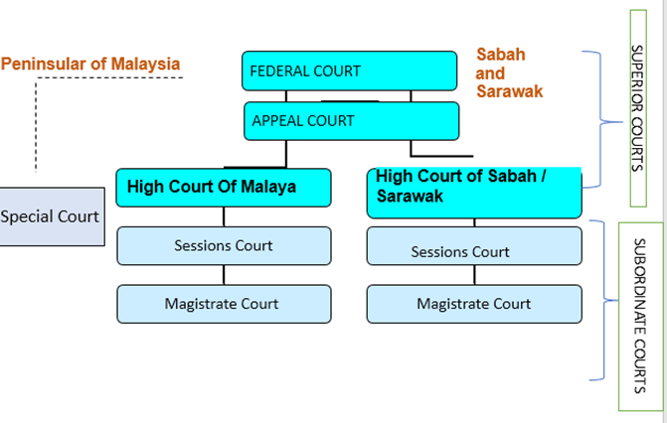
MALAYSIAN COURT SYSTEM
A. Courts at Federal Level | B. Courts at State Level | C. Special Court
● Federal Court | ● Session court | ● Special Court for Royalty
● Appeal Court | ● Magistrate court | ● Children Court
● High Court (every state) | ● Syariah court | ● Industrial Court
 | ● Native/Bumiputera Court (Special court) | ● Military Court
 |  | ● Bumiputera (Native) Court (Sabah and Sarawak)

Slide 21
The Federal Court
Appeal Court
Original Jurisdiction
To determine :
a) the validity of any law made by Parliament or the Legislature of any issues
b) dispute on any other issues between the states or between Federation and any State
Appellate Jurisdiction
To hear appeals from the Court of Appeal and the High Court
Revisionary Jurisdiction:
To determine any question arise before another the Court as to the effect of any provision under the Federal Constitution
Advisory Jurisdiction
The YDPA may refer to the Federal Court for its opinion or advices as the effect of any proviso of the Constitution which has arisen or appears to him likely to arise, and the Federal Court shall pronounce its opinion in open court of any question so referred to it.
Jurisdiction
Under Article 121(B) of the federal Constitution, the jurisdiction of the Court of Appeal is to determine appeal from the decision of the high Court in relation to the civil and criminal cases and any other jurisdiction given by or under the federal law.

Slide 22
High Court
High Court refers to:
the High Court of Malaya (will hear cases and disputes that take place in the jurisdiction of the Peninsular Malaysia)
the High Court of Sabah & Sarawak (will hear cases and disputes that take place in its jurisdiction in Sabah and Sarawak only)
Original Criminal Jurisdiction – hear criminal matters involving death penalty
Original civil jurisdiction
hear and determine all civil matters which are beyond the jurisdiction of the Session and Magistrate Court (amount more RM1 million) and the high Court have the exclusive power to hear all the disputes pertaining to the divorce and matrimonial matters; admiralty; bankruptcy, and companies civil disputes; the appointment and guardianship of infant and the property; the appointment and guardianship of the disable person and the property and letter of administration and probate issues.
Appellate Jurisdiction – hear criminal and civil appeals from the Sessions and Magistrate Courts

Slide 23
Session Court
Magistrate Court
Civil Jurisdiction – hear civil cases such as accident claims, dispute between the landlord and tenant for the value more RM100k but not exceeding RM1million only.
Criminal Jurisdiction – hear all criminal cases excerpt for the case subject to death penalty
Civil Jurisdiction – total amount disputes or claims less than RM100k only
Criminal Jurisdiction – heal all criminal offences which subject to fine and imprisonment not exceeding 10 years of or fine and may sentence not exceeding 5 years imprisonment, fine not exceeding RM10k or 12 times whipping.

Slide 24
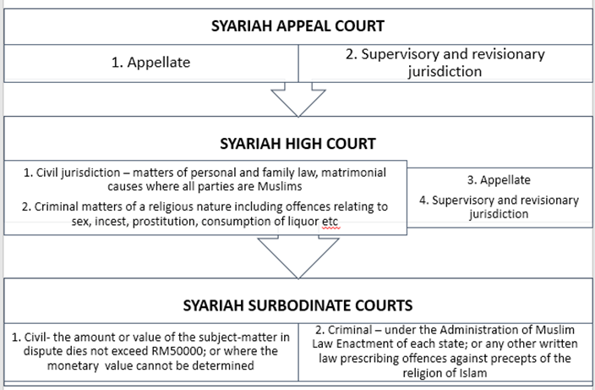
SYARIAH COURT

Slide 25
APPOINTMENT OF JUDGES
Article 122B of the Federal Constitution provides for the appointment of the Chief Justice, the President of the Court of Appeal, the Chief Judges of the High Courts and the other judges of the Federal Court by the Yang di-Pertuan Agong; must acting on the advice of the Prime Minister, after consulting the Conference of Rulers.
Before tendering his advice, the Prime Minister shall, except for the appointment of the Chief Justice, consult the Chief Justice
COURT’S POWERS
To hear and determine disputes on rights and liabilities between
Federal Government and State Government
Between States
Citizens and the Federal Government or the State
Between citizens and citizens
b. Determine if someone has committed a crime or not, and the appropriate punishment.

Slide 26
JUDGES OF THE SUPERIOR COURTS
A judge of the superior court
holds office until the age of 66 years or such later time, not being later than six months after he attains that age, as the Yang di-Pertuan Agong may approve
may resign at any time by writing under his hand addressed to the Yang di-Pertuan Agong
cannot be removed from the office except in accordance with Article 125 of Federal Constitution, that is, if the Prime Minister or the Chief Justice after consulting the Prime Minister, represents to the Yang di-Pertuan Agong that he ought to be removed on the ground of–
any breach of the code of ethics (Code of Ethics 2019); or
inability, from infirmity of body or mind or any other cause, properly to discharge the functions of his office
The representation shall be referred to a tribunal appointed by the Yang di-Pertuan Agong and he may be removed from office on the recommendation of such tribunal.
The said tribunal shall consist of not less than five persons who hold or have held office as judges of the superior courts or have held equivalent office in any other part of the Commonwealth

Slide 27
may be suspended from the exercise of his functions as a judge pending the report of the tribunal
remuneration provided for by law and charged on the Consolidated Fund (Article 125 (6) of Federal Constitution)
remuneration and other terms of office cannot be altered to his disadvantage after his appointment
the validity of anything done by him shall not be questioned on the ground that he had attained the age at which he was required to retire
conduct shall not be discussed in the Legislative Assembly of any State but Parliament may do so on substantive motion of which notice has been given by not less than one quarter of the total number of members of that House; and
stands in similar position as ministers of the Federal Cabinet, members of the State Executive Councils, members of Parliament and State Assemblymen in that he is not a public servant.

Slide 28
JUDGE
Responsibility
To judge in cases that are brought to trial/hearing- determine the method, issues etc. that is brought by the parties involved
To determine the meaning of laws and its relation to certain circumstances
To receive law into the body of law in existence common law and statutes
SPECIAL PRIVILEGES OF A JUDGE
Special privileges so a judge can carry out his duties with justice, and without fear or favour.
Evidence
A Federal Court, Appeal Court and High Court judge’s conduct cannot be discussed in any house of Parliament unless there is ¼ support from the members of Parliament.
Cannot discuss at the conduct of a judge in State Legislative Assembly
Judge cannot be stripped of his position by the YDPA before 66 years of age unless based on the recommendation of a tribunal: A. 125(3) of the Fed Constitution
Stated in the Constitution that judiciary cannot be subject to control by the legislative and executive.

Slide 29
HOW ARE LAWS ENFORCED?
Summons case
Magistrate issues a summons
Arrest warrant
Issued by the magistrate
Stated in the charge
Order from Deputy Public Prosecutor
Issued when the police find that a non-seizable offence case is serious
Seizable offence
Police can arrest when there is sufficient information, investigation and evidence, and bring to court within 24 hours

Slide 30
THE CONCEPT OF JUDICIAL INDEPENDENCE
The functions of judicial independence:
to set out and also protect political rights, civil liberties and also the rule of law
judges must be free to interpret the laws independently, impartially and objectively without subject to any undue outside pressure from the police, the government, the military, public opinion, or any other interested body or person in order for justice to be performed.

Slide 31
INDEPENDENCE OF THE JUDICIARY IN MALAYSIA
Characteristic of Judiciary in Malaysia: Doesn’t take sides, independent and free
Court cannot be controlled by any other executive bodies
Service of judges are excluded from the General Rules in A. 132 (A)
Judge can only be removed when there is a recommendation from the TRIBUNAL. A. 125 (3), (4) and (5).
Parliament cannot discuss the conduct of a judge unless supported by ¼ members of parliament

Slide 32
CONCLUSION
• Legislative and judiciary – important as mechanism of check and balance
• Parliament plays an important role as a legislative body.
• Judiciary in Malaysia - the only government body that does not have overlapping members as legislation and executive.

Slide 33
Reflection
What are the main function of legislative and judiciary?
What are the stages involved in the drafting the bills?
Which stage is proposing ideas or discussing the important aspects to be draft as a bill?
Who are the person usually in charge of introducing the bill to the members of Parliament?
Please draw the stages and flow in drafting the bill.
What is the process happened in Second Reading?
How many days for the Yang di-Pertuan Agong need to grant the assent for a bill?
Who is the head of legislative body?
Who are the members of Dewan Rakyat?
How long the tenure of members of Dewan Rakyat?
What is the minimum age of the member of Dewan Negara?
What is the main role of Dewan Negara?
How the Chief of Judge is appointed?
What is the responsibility of a judge?
What is the position of Syariah court in the Malaysian court system?
What do you understand about the Judicial Independence?

